Slide 1
Balanced Binary Search Tree
Course : COMP6048 – DATA STRUCTURE
Year : 2017

Slide 2
Learning Outcomes
At the end of this session, student will be able to:
Ilustrate construction process of AVL Tree (LO1 & LO3)

Slide 3
Sub Topics
Balanced Binary Search Tree:
Binary Search Tree Review
Balanced Binary Search Tree
AVL Tree Concept
AVL Tree Operation: Search, Insertion and Deletion
Rebalance AVL Tree
Red Black Tree Concept
Red Black Tree Properties
Red Black Tree Operation: Search, Insertion and Deletion

Slide 4
Binary Search Tree Review
The height of Binary Search Tree can be as large as N-1 (when the BST is skewed)
The time needed to perform insertion, deletion, searching or many other operations are depend on the tree’s height, this means they can be O(n) in worst case

Slide 5
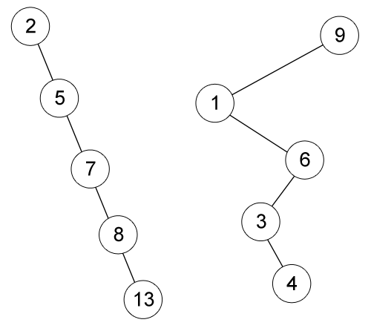
Binary Search Tree Review
Example of skewed Binary Search Tree
The left BST is inserted by 2, 5, 7, 8 and 13 respectively.
The right BST is inserted by 9, 1, 6, 3 and 4 respectively.

Slide 6
Balanced Binary Search Tree
We want a tree with small height.
What is the minimal height of a BST with N nodes?
θ(log n)
Our goal is to keep the height of a BST to be O(log n)
Such trees are called Balanced Binary Search Tree (i.e. AVL Tree, Red Black Tree)

Slide 7
AVL Tree
AVL Tree is named after its two inventors, G.M. Adelson-Veleskii and E.M. Landis in 1962.
AVL Tree is the first self-balancing binary search tree invented.
The tree is named AVL in honour of its inventors

Slide 8
AVL Tree Concept
Height of a node:
The height of an empty sub tree is 0.
The height of a leaf is 1.
The height of an internal node is the maximum height of its children plus 1.
Balance Factor:
The difference height of its LEFT sub tree and its RIGHT sub tree.
The balance factor of all nodes in AVL tree should be at most 1.

Slide 9
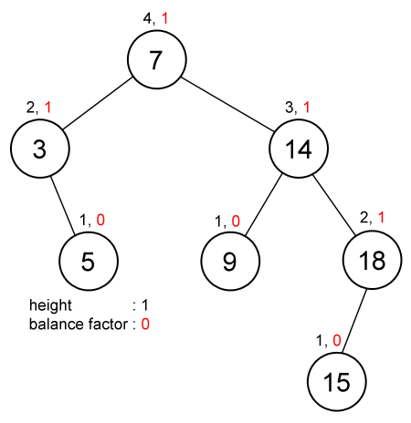
AVL Tree Concept
All nodes’ balance factor
(red font) is at most 1.

Slide 10
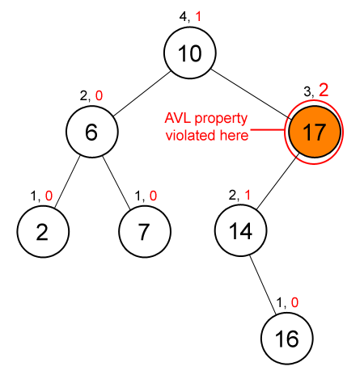
AVL Tree Example
The node contains 17’ (orange color) balance factor is more than 1, so this BST is not an AVL Tree.

Slide 11
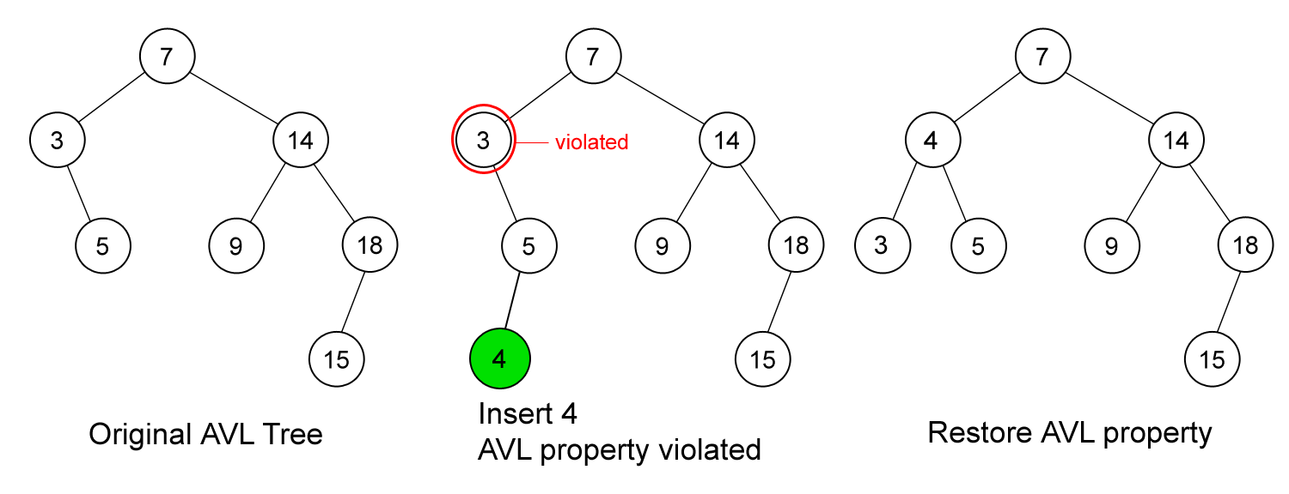
AVL Tree Operations: Insertion
First, insert the new key as a new leaf just as in ordinary Binary Search Tree insert strategy.
But this may cause violation of AVL Tree property.
Next, restore the balance condition.

Slide 12
Rebalance AVL Tree
After an insertion, only nodes that are on the path from the inserted node to the root that might violate the AVL property.
Why?
Rebalance the tree at the deepest level of such nodes guarantees that the property of AVL Tree restored.
Why?
How to rebalance a violated AVL Tree?

Slide 13
Rebalance AVL Tree
Let the node that must be rebalanced be T.
There is 4 cases:
Case 1 : the deepest node is located at the left sub tree of the
left child of T.
Case 2 : the deepest node is located at the right sub tree of the
right child of T.
Case 3 : the deepest node is located at the right sub tree of the
left child of T.
Case 4 : the deepest node is located at the left sub tree of the
right child of T.
Note: In insertion, the deepest node will be the inserted node.

Slide 14
Rebalance AVL Tree
Rebalance of AVL Tree done by rotation.
Violation on case 1 and 2 (left-left or right-right) are fixed by single rotation.
Violation on case 3 and 4 (left-right or right-left) are fixed by double rotation.

Slide 15
AVL Tree Operations: Insertion
First, insert the new key as a new leaf just as in ordinary Binary Search Tree insert strategy.
But this may cause violation of AVL Tree property.
Next, restore the balance condition. How?
Trace the path from the new key towards the root. For each node
P encountered, check if heights of left(P) and right(P) differ by at
most 1.
If Yes, proceed to parent(P).
If No, fix sub tree P either by single rotation or double rotation.

Slide 16
AVL Tree Operations: Insertion
LL rotation: the new node is inserted in the left sub-tree of the left sub-tree of the critical node
RR rotation: the new node is inserted in the right sub-tree of the right sub-tree of the critical node.
LR rotation: the new node is inserted in the right sub-tree of the left sub-tree of the critical node
RL rotation: the new node is inserted in the left sub-tree of the right sub-tree of the critical node

Slide 17
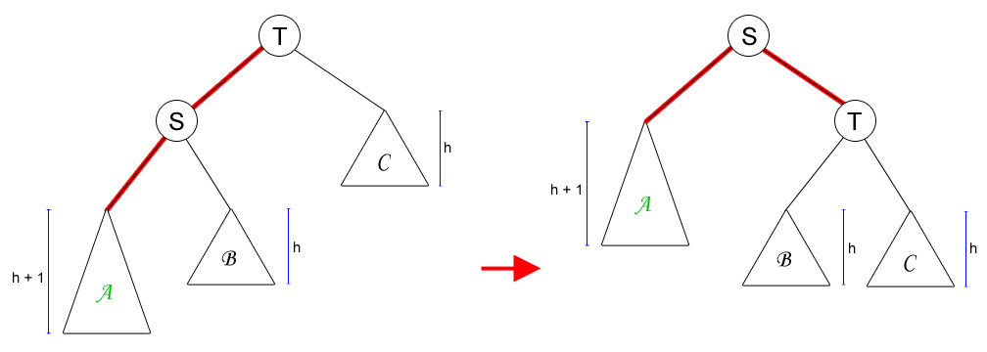
Single Rotation to Fix Case 1 (LL Rotation)
The new key is located at sub tree A.

Slide 18
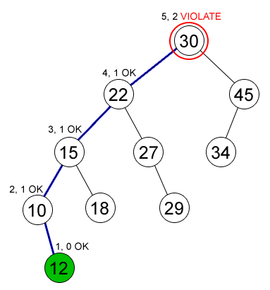
Example on Single Rotation
Node (12) is inserted in an AVL Tree and causing node (30) to violate the AVL property (Case 1)

Slide 19
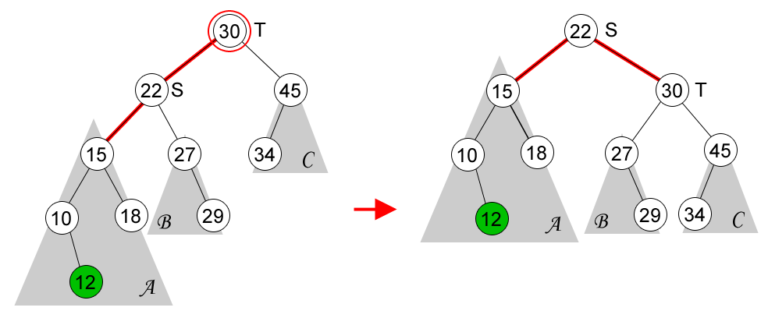
Example on Single Rotation

Slide 20
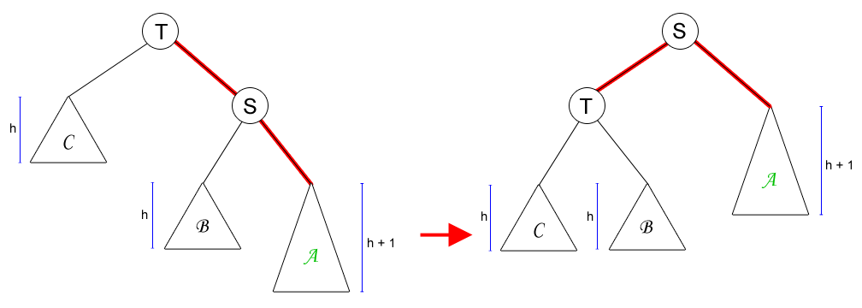
Single Rotation to Fix Case 2 (RR Rotation)
Case 2 is mirror symmetry to Case 1.

Slide 21
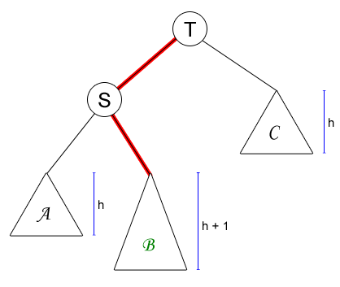
Single Rotation on Case 3 (or 4)
What will happen if we do single rotation on case 3 or 4?

Slide 22
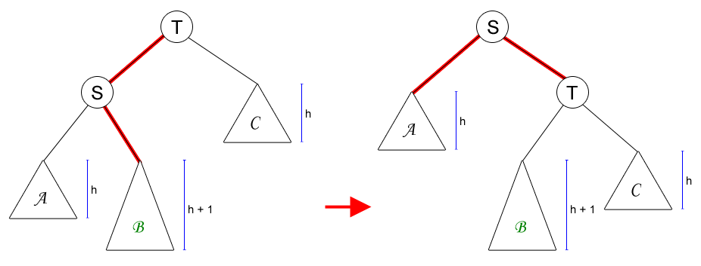
Single Rotation on Case 3 (or 4)
The AVL property is violated at node S (the height of its left-sub tree is h and the height of its right-sub tree’s is h+2).
Single rotation is not solving our problem on Case 3 or 4.

Slide 23
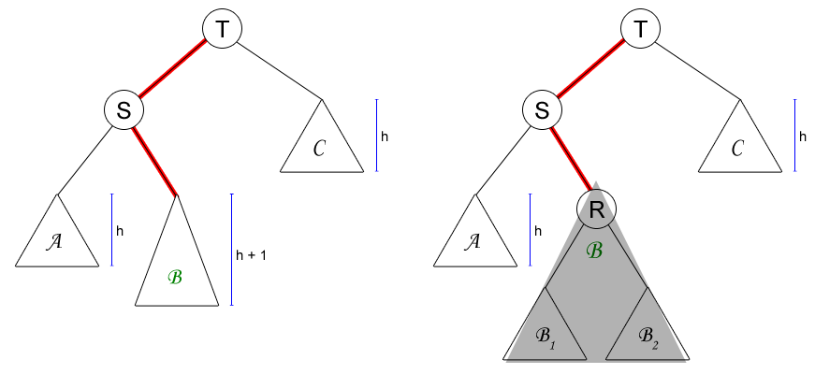
Double Rotation to Fix Case 3 (LR Rotation)
A deeper look at sub tree B

Slide 24
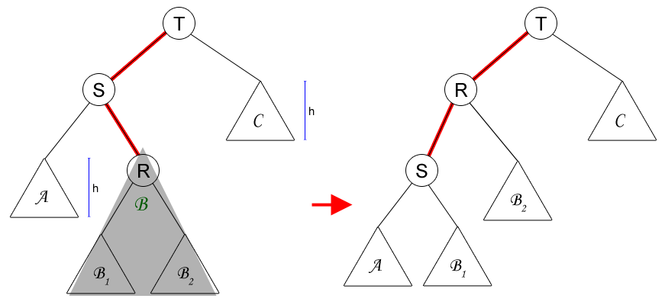
Double Rotation to Fix Case 3 (LR Rotation)
First rotation: node R and S.

Slide 25
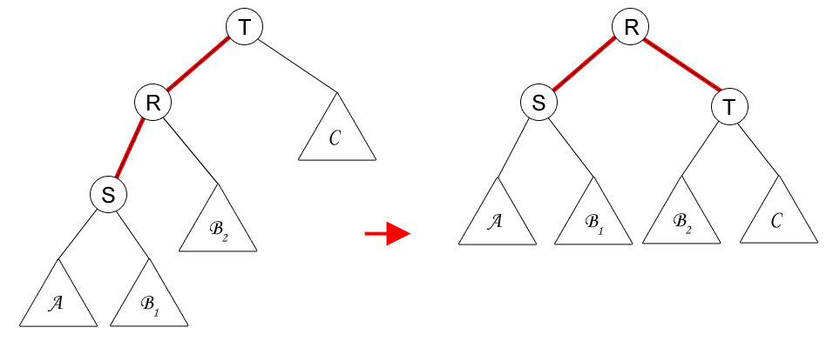
Double Rotation to Fix Case 3 (LR Rotation)
Second rotation: node R and T.

Slide 26
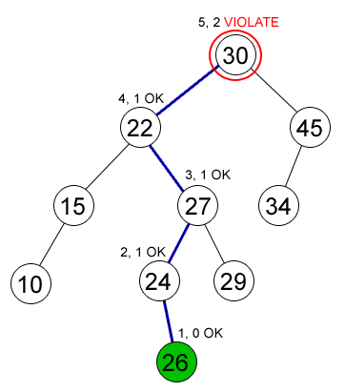
Example on Double Rotation
Node (26) is inserted in an AVL Tree and causing node (30) to violate the AVL property (Case 3)

Slide 27
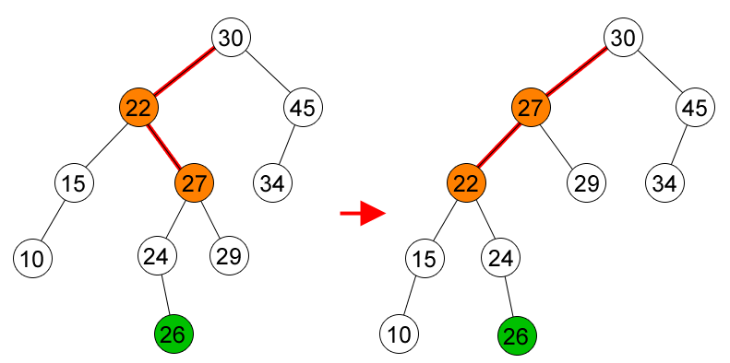
Example on Double Rotation
First rotation, node (27) and node (22).

Slide 28
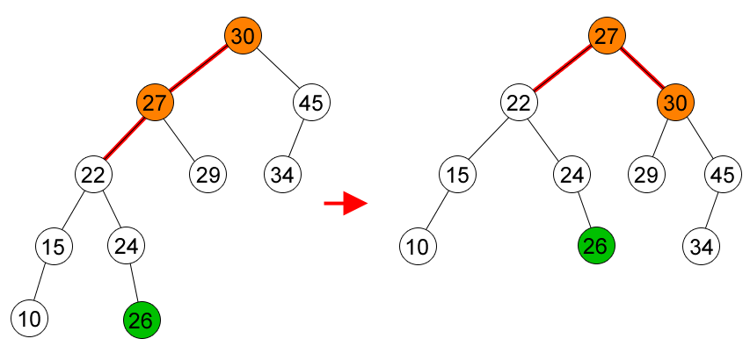
Example on Double Rotation
Second rotation, node (27) and node (30).

Slide 29
AVL Tree Operations: Deletion
Delete the node as in ordinary Binary Search Tree.
The deleted node will be a leaf or a node with one child.
Trace the path from the (parent of) deleted leaf towards the root. For each node P encountered, check if height of left(P) and right(P) differ by at most 1.
If Yes, proceed to parent(P).
If No, fix sub tree P either by single rotation or double rotation (as in insertion).
After we perform rotation at P, we may have to perform a rotation at some ancestor of P. Thus, we must continue to trace the path until we reach the root.

Slide 30
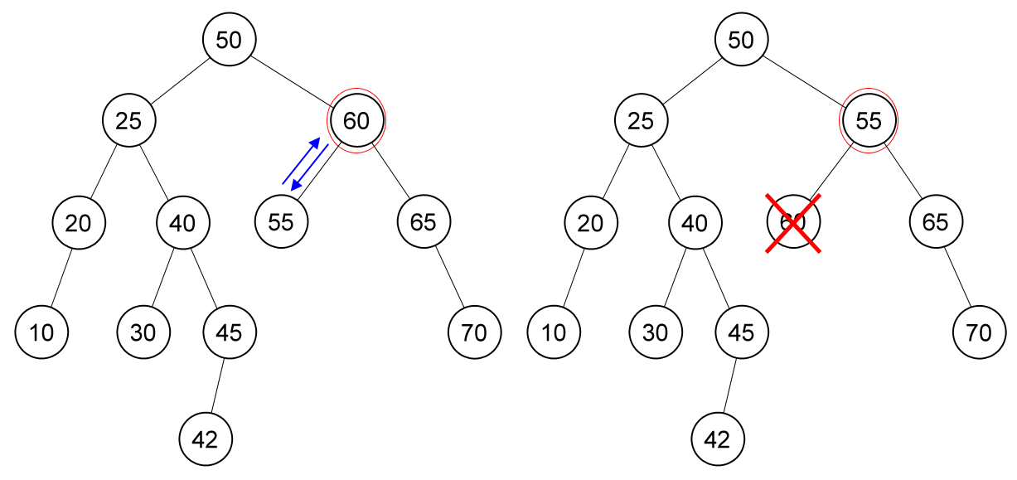
Example on Deletion
Delete node (60), node (55) is unbalanced.

Slide 31
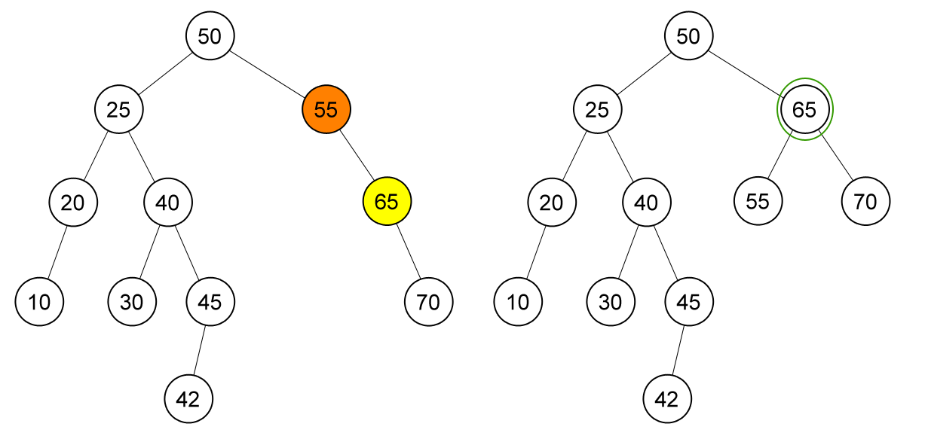
Example on Deletion
Single rotation on node (55)

Slide 32
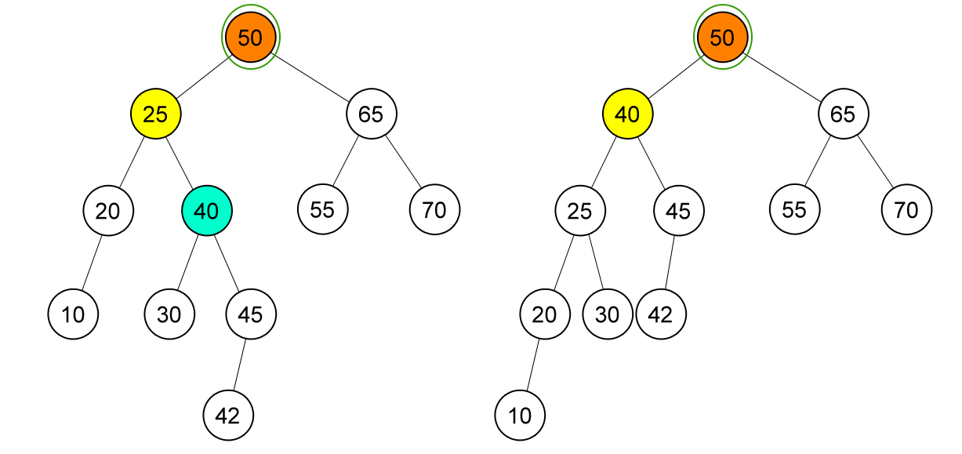
Example on Deletion
Node (50) is unbalanced, double rotation on node (50)

Slide 33
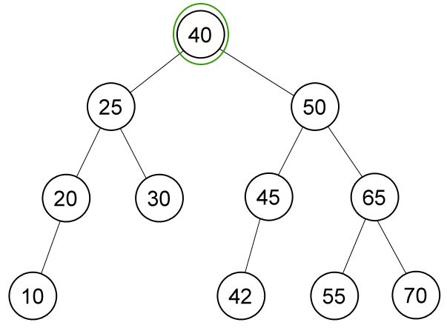
Example on Deletion
AVL Tree after deletion of node (60)

Slide 34
Red Black Tree Concept
Red Black Tree is another self-balancing binary search tree.
Because a red black tree is a binary search tree, searching in red black tree is the same as searching in binary search tree.

Slide 35
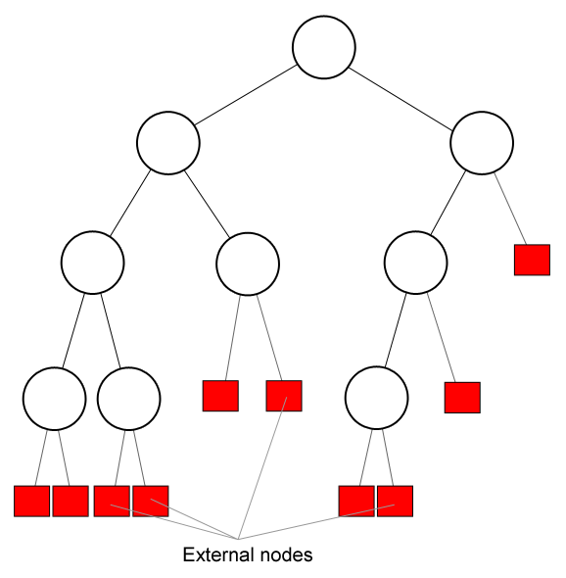
Red Black Tree Concept (External Nodes)
External nodes are leaves’ “dummy” children. If a new node is inserted, it will be placed in one of the external nodes.
External nodes are physically not exists in our tree, but we will use external nodes to simplify some algorithms for operating in red black tree.

Slide 36
Red Black Tree Properties
A binary search tree is a red black tree if:
Every node has a color, either red or black.
Root is black by default.
All external nodes are black.
If a node is red, then both its children are black.
The 4th property implies that:
There is no red node has a red parent.
Every simple path from a given node to any of its descendant external nodes contains the same number of black nodes.

Slide 37
Red Black Tree Applications
Red Black Trees offer worst case time guarantee for insertion, deletion, and search operations
Red Black Trees are not only valuable in time-sensitive applications such as real-time applications
Red Black Trees are preferred to be used as a building block in other data structures which provide worst-case guarantee

Slide 38
RBT Operations: Insertion
Insert a new node just like inserting in binary search tree (it should be located in one of the external nodes)
That new node is red
Fix any red black tree violation
If the parent is black, then no violation occurred.
If the parent is red, then violation occurred (no red node has red parent).

Slide 39
RBT Operations: Insertion
Fixing the violation
Let the new node be q, its parent be p, and sibling of parent be s (uncle of q). If parent doesn’t have sibling, then s is black (an external node is black).
If s is red, then change p and s to black and parent of p to red.
If s is black, do rotation (single or double), change the last rotation pivot be black and their child be red.

Slide 40
RBT Operations: Insertion
The new inserted node is X. X’s parent is black, so no violation occurred.
or

Slide 41
RBT Operations: Insertion
The new inserted node is X (or Z in the right picture). Its parent is red, so violation occurred. Its uncle (sibling of its parent) is red, so change its parent and its uncle to black and change its grandparent to red.

Slide 42
RBT Operations: Insertion
The new inserted node is X (or Z in the right picture). Its parent is red, so violation occurred. Its uncle (sibling of its parent) is black and path to its parent is the same with path to its grandparent (left-left or right-right), so single rotate at its grandparent and change its parent to black and its sibling (ex-grandparent) to red.

Slide 43
RBT Operations: Insertion
The new inserted node is X (or Z in the right picture). Its parent is red, so violation occurred. Its uncle (sibling of its parent) is black and path to its parent is different with path to its grandparent (left-right or right-left), so double rotate at its parent and at its grandparent (just like in AVL tree). Change the last rotation pivot to black and their children to red.

Slide 44
RBT Operations: Deletion
Deleting a node is just like deleting in binary search tree
(if it is a node with two children, find the maximum element in its
left sub-tree or minimum element in its right sub-tree).
Let the node to be deleted be M, and its child be C.
If M is red, then simply replace it with C which must be black by definition.
If M is black and C is red, replace it with C and recolor C with black.
What if M and C are black?

Slide 45
RBT Operations: Deletion
If M and C are black, replace M with C. Let’s denote C in its new position be N (it’s also called a double black), its parent be P, its sibling be S, S_{L} be S’s left child and S_{R} be S’s right child.
If S is red, reverse the color of N and P, and rotate at P.
If S, S_{L} and S_{R} are black, then recolor S as red.
If S is black and S_{L} or S_{R} is red, then single rotate or double rotate.

Slide 46
RBT Operations: Deletion
a is a double black node, its sibling is red so rotate at X and recolor X and Y.

Slide 47
RBT Operations: Deletion
a is a double black node, its sibling is black and both its sibling children are black, so recolor its sibling to red.

Slide 48
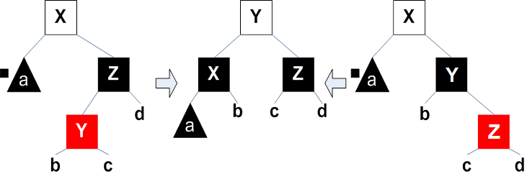
RBT Operations: Deletion
a is a double black node, its sibling is black and one of its sibling’s children is red, so do single/double rotation.

Slide 49
Summary
AVL Tree is the first self-balancing binary search tree invented.
The balance factor of all nodes in AVL tree should be at most 1
Restoring the balance condition is done by tracing the path from the new key towards the root. For each node P encountered, check if heights of left(P) and right(P) differ by at most 1

Slide 50
Summary
Red Black Tree is self-balancing binary search tree.
External nodes are leaves’ “dummy” children
External nodes are physically not exists in our tree, but we will use external nodes to simplify some algorithms for operating in red black tree
Insert a new node just like inserting in binary search tree

Slide 51
References
Reema Thareja,. 2014. Data structures using C. OXFOR. New Delhi. ISBN:978-0-19-809930-7 Chapter 10
AVL Tree
http://www.cs.usfca.edu/~galles/visualization/AVLtree.html

Slide 52
END
Balanced Binary Search Tree

